Slide 1
CS174A Lecture 8

Slide 2
Announcements & Reminders
Midterm: Oct 29
Midterm study guide posted in Piazza
Team project proposals due: Oct 29
Project #3 assigned in Piazza/Github

Slide 3
TA Session This Friday
Team project
First draft of proposal due: 10/29/19
What’s expected in the proposal
Still looking for teammates? Resolve this Friday
Project assignment #3
Midterm review

Slide 4
Last Lecture Recap
Spaces:
Model space
Object/world space
Eye/camera space
Screen space
Projections: Parallel and Perspective

Slide 5
Next Up
Projections: parallel and perspective
Orthographic and perspective view volumes
Canonical (normalized) view volume
Backface Culling
Hidden Surface Removal
Flat and Smooth Shading: introduction
Lighting

Slide 6
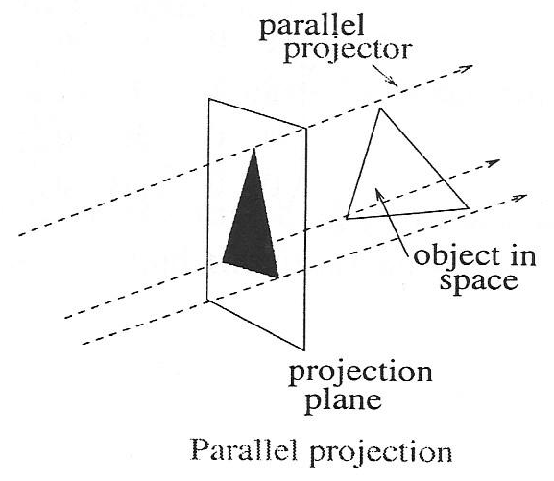
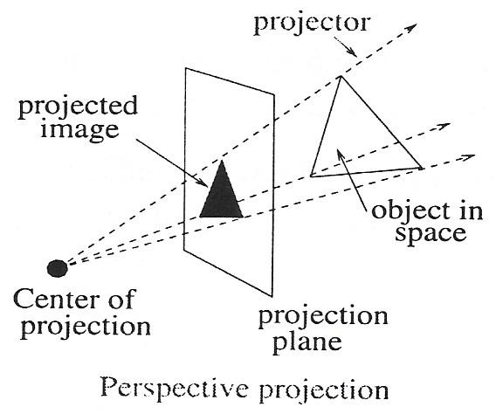
Projections

Slide 7

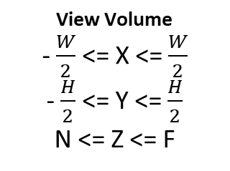
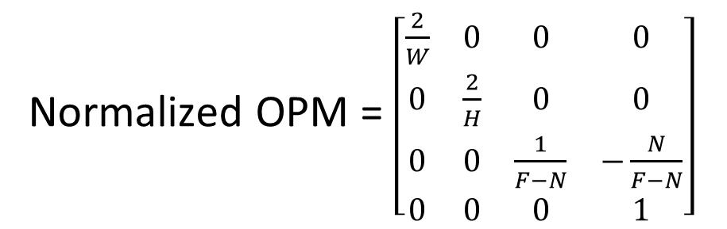
Orthographic Projection
Orthographic PM = $\left[\begin{matrix}1 & 0 & 0 & 0 \\ 0 & 1 & 0 & 0 \\ 0 & 0 & 1 & 0 \\ 0 & 0 & 0 & 1\end{matrix}\right]$
View Volume
- $\frac{W}{2}$ <= X <= $\frac{W}{2}$
- $\frac{H}{2}$<= Y <= $\frac{H}{2}$
N <= Z <= F
Normalized OPM = $\left[\begin{matrix}\frac{2}{W} & 0 & 0 & 0 \\ 0 & \frac{2}{H} & 0 & 0 \\ 0 & 0 & \frac{1}{F−N} & −\frac{N}{F−N} \\ 0 & 0 & 0 & 1\end{matrix}\right]$
Canonical View Volume
-1 <= X’ <= 1
-1 <= Y’ <= 1
0 <= Z’ <= 1

Slide 8
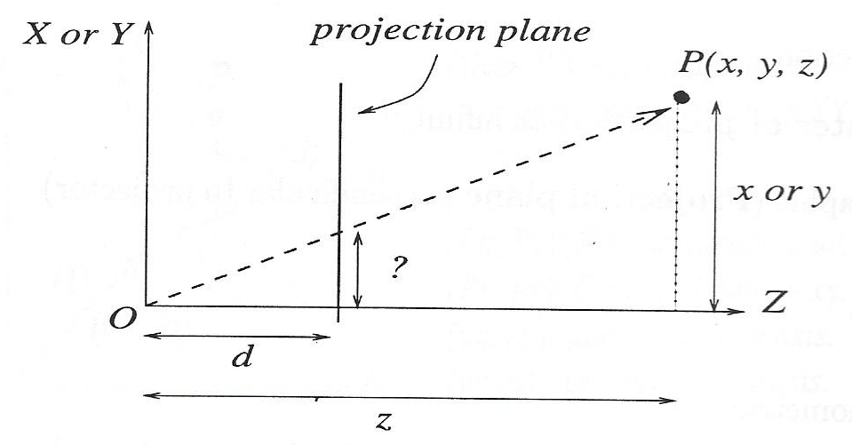
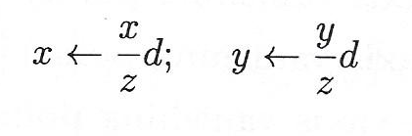
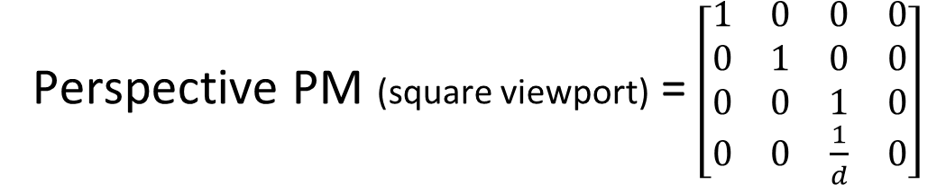
Perspective Projection
Perspective PM (square viewport) = $\left[\begin{matrix}1 & 0 & 0 & 0 \\ 0 & 1 & 0 & 0 \\ 0 & 0 & 1 & 0 \\ 0 & 0 & \frac{1}{d} & 0\end{matrix}\right]$

Slide 9
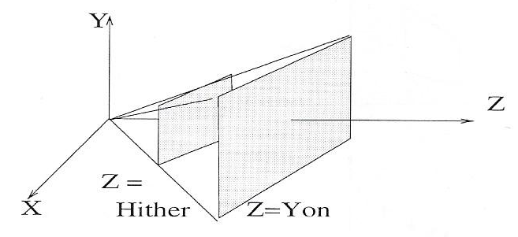
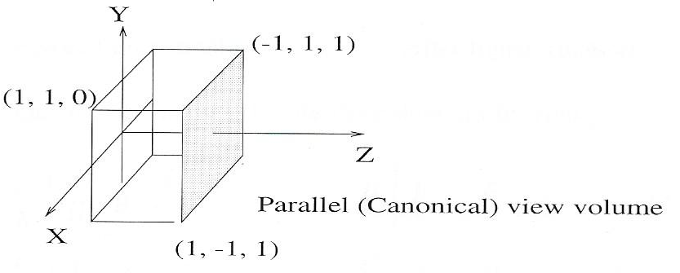
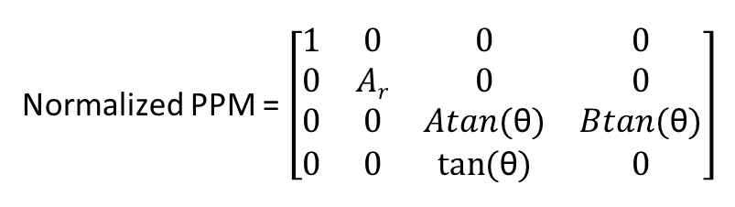

Perspective Projection
Aspect Ratio (A_{r}) = $\frac{W}{H}$
Half Angle of View = θ
Normalized PPM = $\left[\begin{matrix}1 & 0 & 0 & 0 \\ 0 & Ar & 0 & 0 \\ 0 & 0 & Atan(\text{θ}) & Btan(\text{θ}) \\ 0 & 0 & tan⁡(\text{θ}) & 0\end{matrix}\right]$

Slide 10
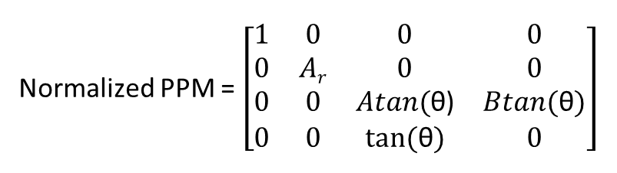
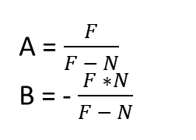
Perspective Projection
Normalized PPM = $\left[\begin{matrix}1 & 0 & 0 & 0 \\ 0 & Ar & 0 & 0 \\ 0 & 0 & Atan\text{(}\text{θ}\text{)} & Btan(\text{θ}) \\ 0 & 0 & tan⁡(\text{θ}) & 0\end{matrix}\right]$
A = $\frac{F}{F − N}$
B = - $\frac{F ∗N}{F − N}$
Apply Perspective Division
How to handle –ve values of w? What does it mean?

Slide 11

Window-to-Viewport Mapping
Change from normalized volume (xyz) to screen coordinates (XY)
xyz: normalized point after perspective division
XY: screen coordinates
v_{l},v_{b}: lower-left corner of viewport
v_{r},v_{t}: upper-right corner of viewport
X = x$\frac{vr −vl}{2}+ \frac{vr+vl}{2}$
Y = y$\frac{vt −vb}{2}+ \frac{vt+vb}{2}$

